Slide 1
Medical Genomics: Single-cell Transcriptomics
N. Alcala & L. Mangé
Computational Cancers Genomics Team
November 25th 2025

Slide 2
Plan
Part I. Transcriptomics
Concepts
Resources: databases
Part II. Single-cell transcriptomics
Concepts
Techniques
Analysis: preprocessing & onwards

Slide 3
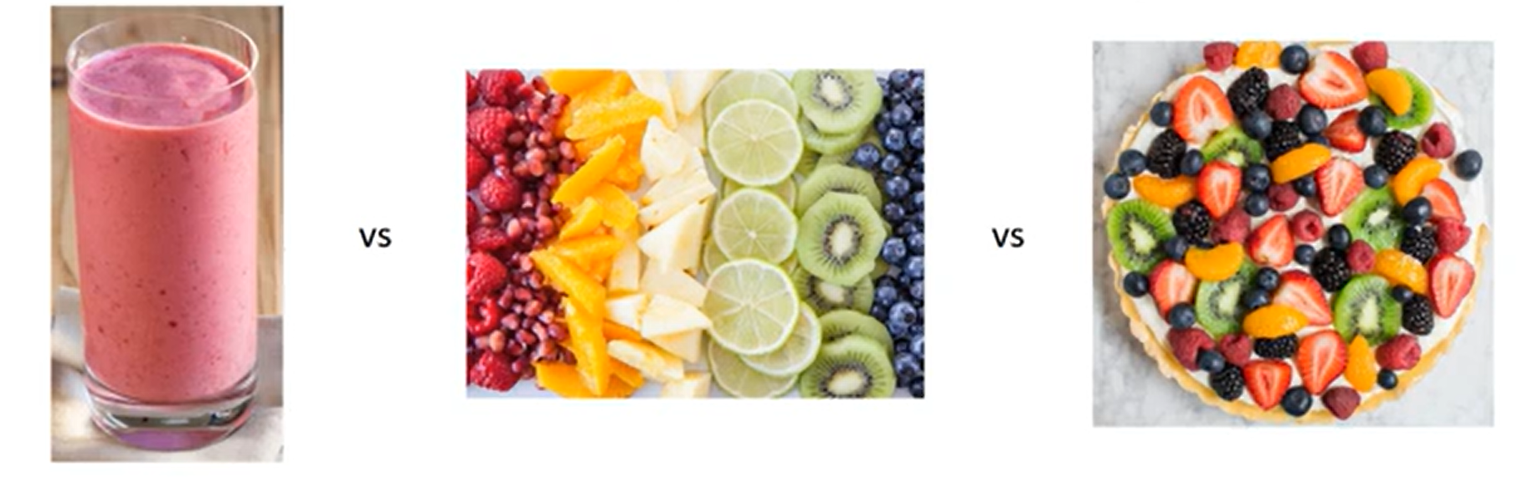
Part I. Transcriptomics | Concepts
Transcriptomics: study of the transcriptome -> transcripts made from genes expressed
Helps us understand:
How gene expression influences tumor biology, progression, and treatment response
Tumor tissue heterogeneity (intra- & inter-)
Bulk RNAseq
scRNAseq
Spatial RNAseq
Advanced Cell Diagnostics. (29 oct. 2019). ASHG 2019 scRNAseq HiPlex oral presentation [Video]. YouTube. https://www.youtube.com/watch?v=YlRemO_TE3Y

Slide 4
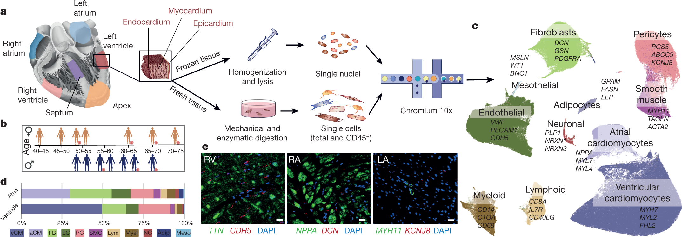
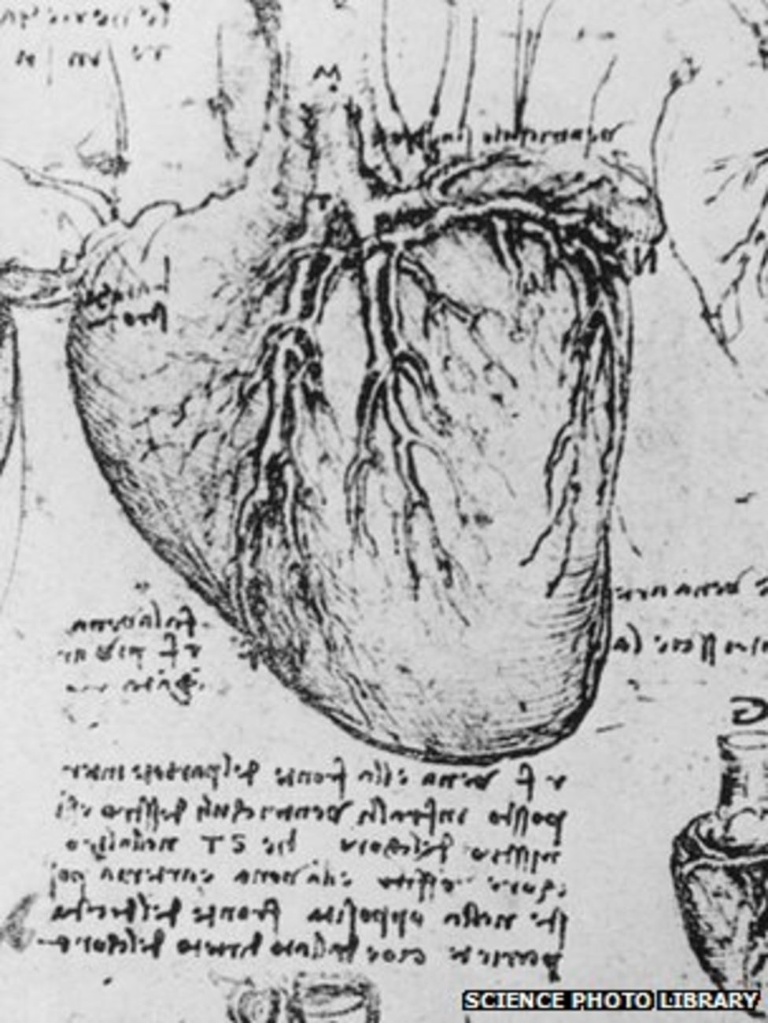
Part I. Transcriptomics | Concepts
Tissue heterogeneity
Tissues are made of mixtures of cells
The investigation of tissue heterogeneity gained novel traction with new sequencing technologies
Heart anatomy. Da Vinci
circa 1510.
Human heart cell composition. Percentage of cell types estimated from single-cell RNA-seq. Source: Litviňuková et al. Nature 2020.

Slide 5
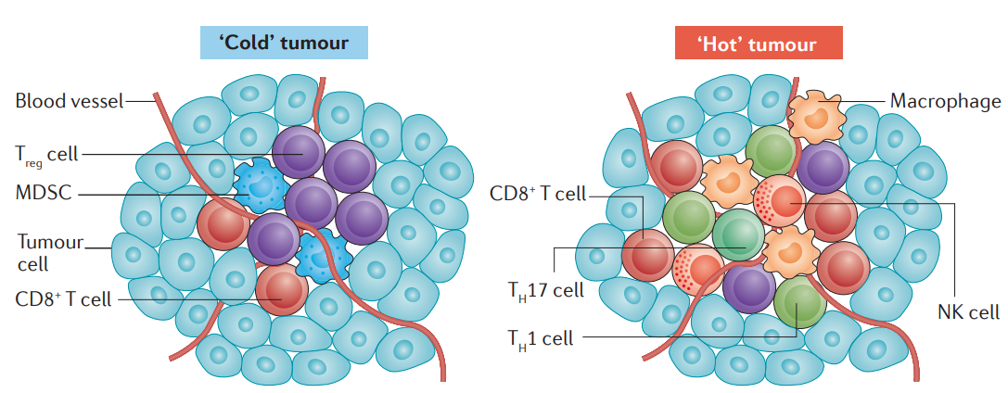
Part I. Transcriptomics | Concepts
Tissue heterogeneity: Tumor microenvironment (TME)
Tumors have various amounts and compositions of Tumor Infiltrating Lymphocytes (TILs)
TILs influence disease progression
Tumors differ in their level of infiltration. Source: Nagarsheth et al. Nat Rev Immun 2017.

Slide 6
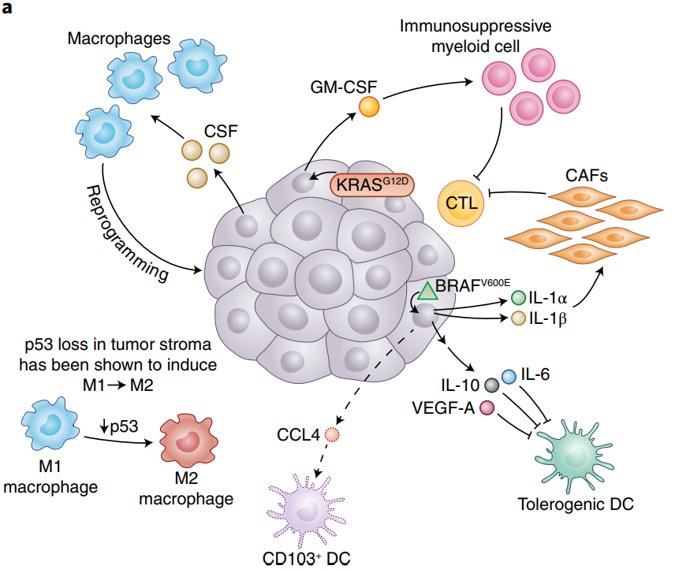
Part I. Transcriptomics | Concepts
Tumors shape their microenvironment
Tumors can establish protumoral and immunosuppressive environments
They recruit stromal and immune cells to suppress the immune response (e.g., fibroblasts), promote metastasis (e.g. macrophages) by increasing angiogenesis (blood vessel formation providing nutrients to the tumor)
Tumors genotypes and phenotypes shape the TME. In melanoma KRAS somatic alterations promote the recruitment of immunosuppressive cells. Source: Binnewies et al. Nature Medicine 2018.

Slide 7

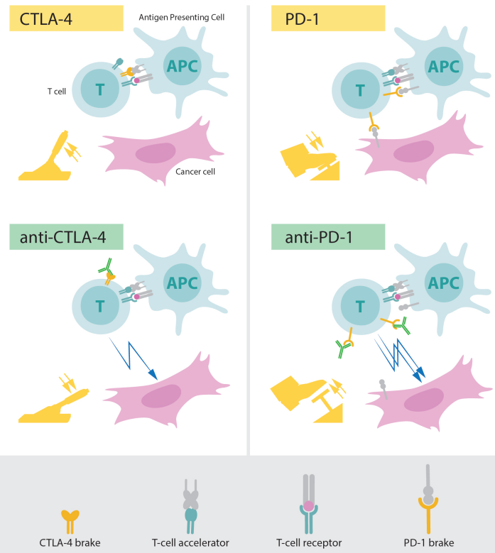
Part I. Transcriptomics | Concepts
The TME is associated with the tumor genome and response to therapy
Hot tumors respond better to immunotherapy
Cancer cell
Antibody
"Removing the brakes" on the immune response.

Slide 8
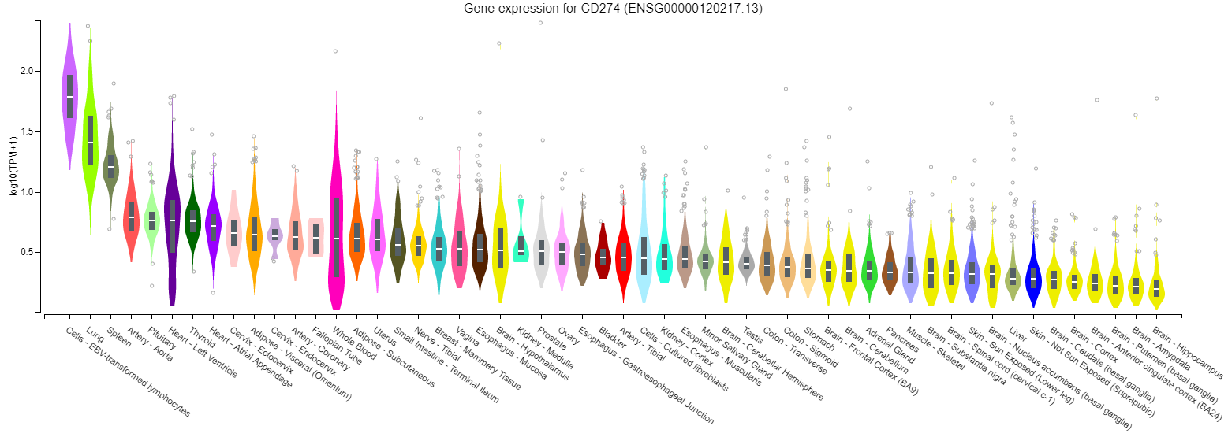
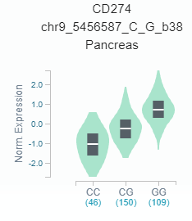
Part I. Transcriptomics | Resources
The Genotype-Tissue Expression (GTEx) project
Database of tissue-specific gene expression and regulation
54 non-diseased tissue sites for 1000 individuals with WGS/WES, and RNA-Seq
gene expression, expression quantitative trait loci (eQTL), and histology images
Expression of immune checkpoint gene PD-L1 in 52 tissues.
Example Pancretic eQTL. Gene expression varies as a function of genotype at locus chr9 5456587

Slide 9
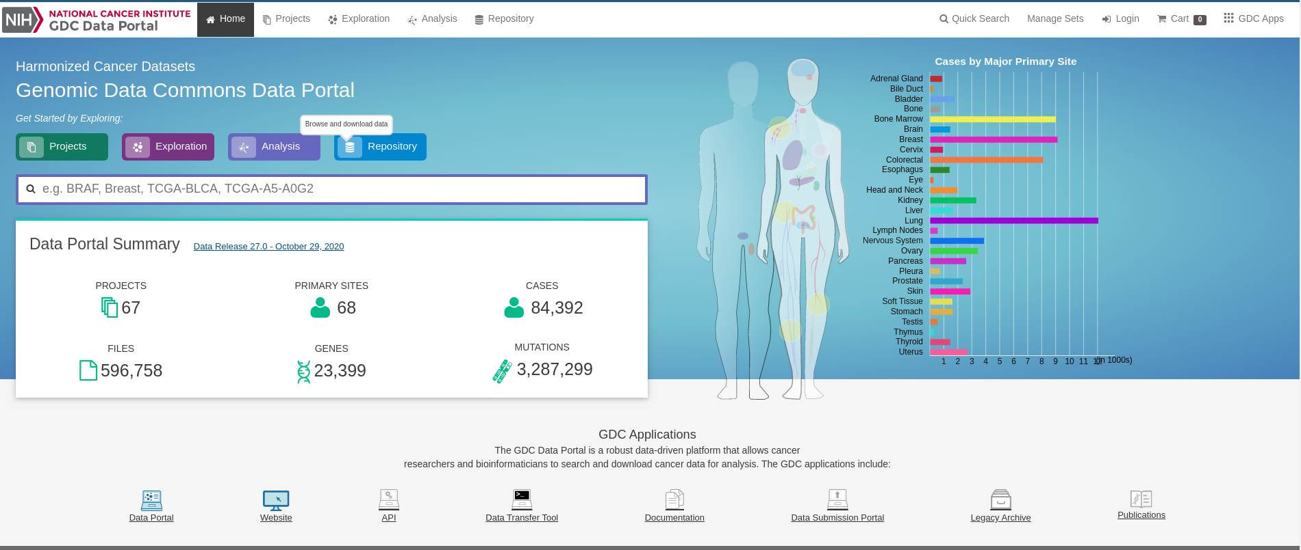
Part I. Transcriptomics | Resources
The Cancer Genome Atlas (TCGA) project
Database of cancer multi-omic data for
Tumors from 33 primary sites
Genomic, epigenomic, transcriptomic, and proteomic data
RNA-seq data under controlled access (requires research institute affiliation)
Processed gene expression data (read counts and FPKM) open-access
Web interface of the genomic data portal hosting the TCGA data. Source: https://portal.gdc.cancer.gov/.

Slide 10
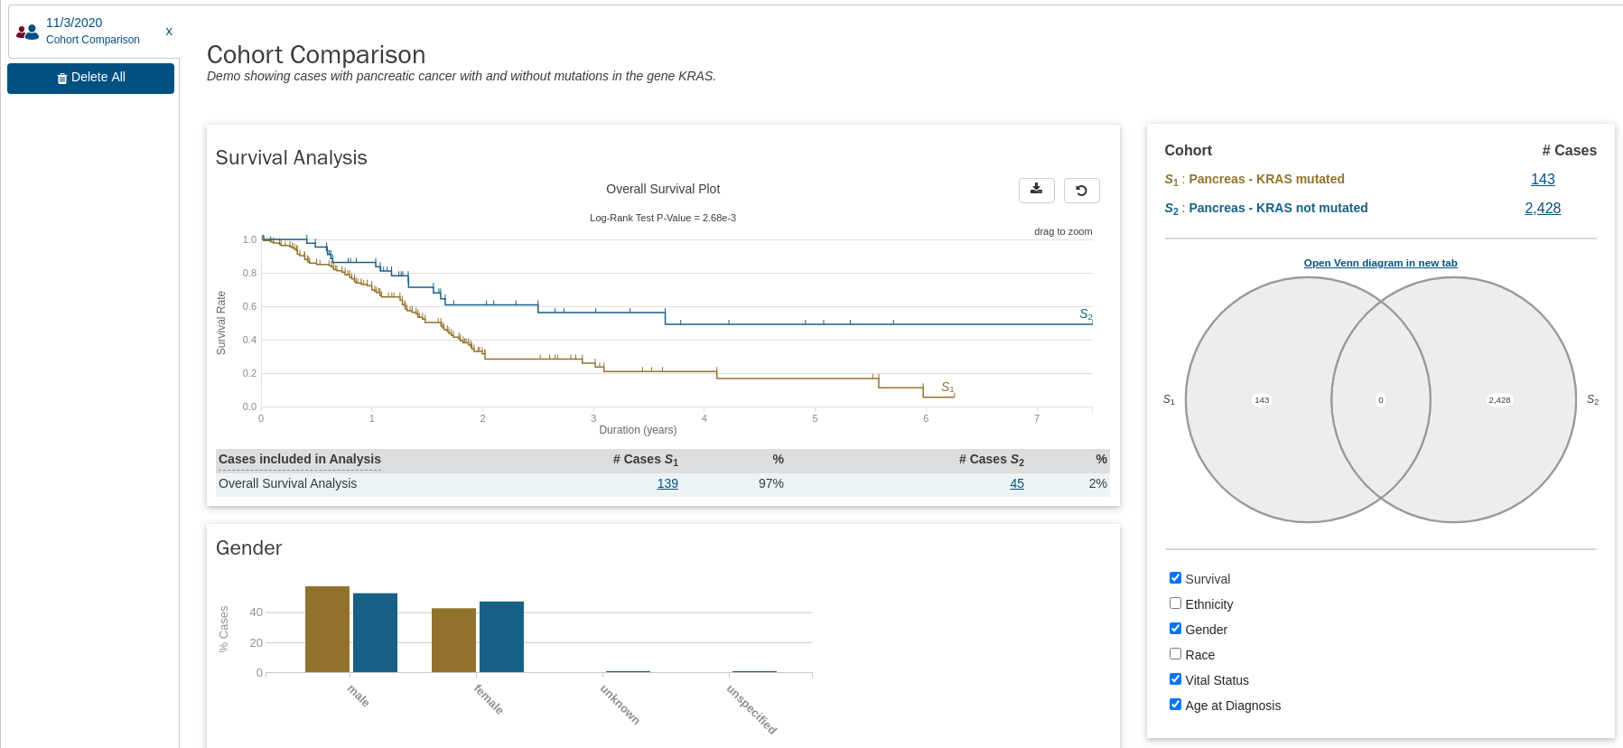
Part I. Transcriptomics | Resources
The Cancer Genome Atlas (TCGA) project
Database of cancer multi-omic data for
Tumors from 33 primary sites
Genomic, epigenomic, transcriptomic, and proteomic data
RNA-seq data under controlled access (requires research institute affiliation)
Processed gene expression data (read counts and FPKM) open-access
Data can be visualized and basic analyses can be performed
Example analysis that can be performed on the GDC portal. Survival analysis in pancreatic cancer based on KRAS mutational status. Source: https://portal.gdc.cancer.gov/.

Slide 11
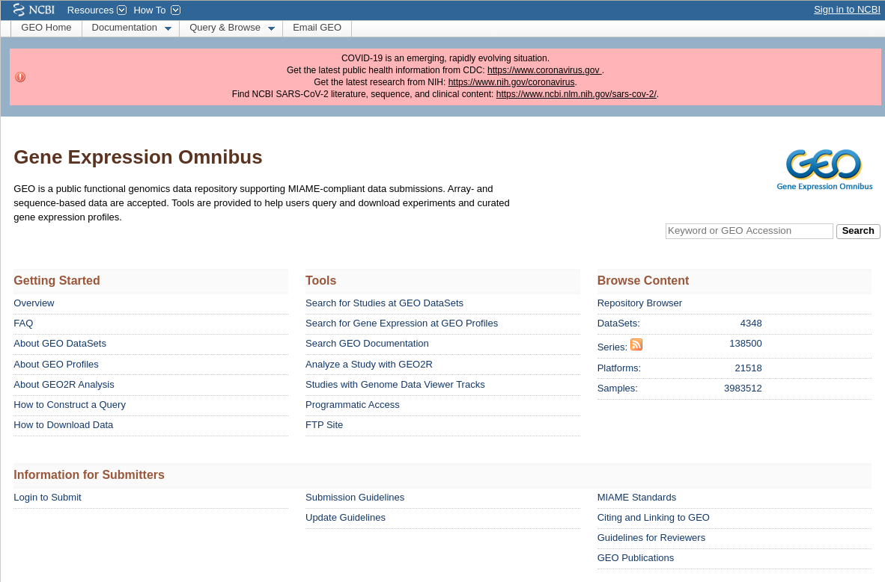
Part I. Transcriptomics | Resources
The Gene Expression Omnibus (GEO) repository
Database of expression data (arrays and RNA-seq)
Includes human data
Not only cancer
All data is open-access
Web interface of the gene expression omnibus repository. Source: https://www.ncbi.nlm.nih.gov/geo/.

Slide 12
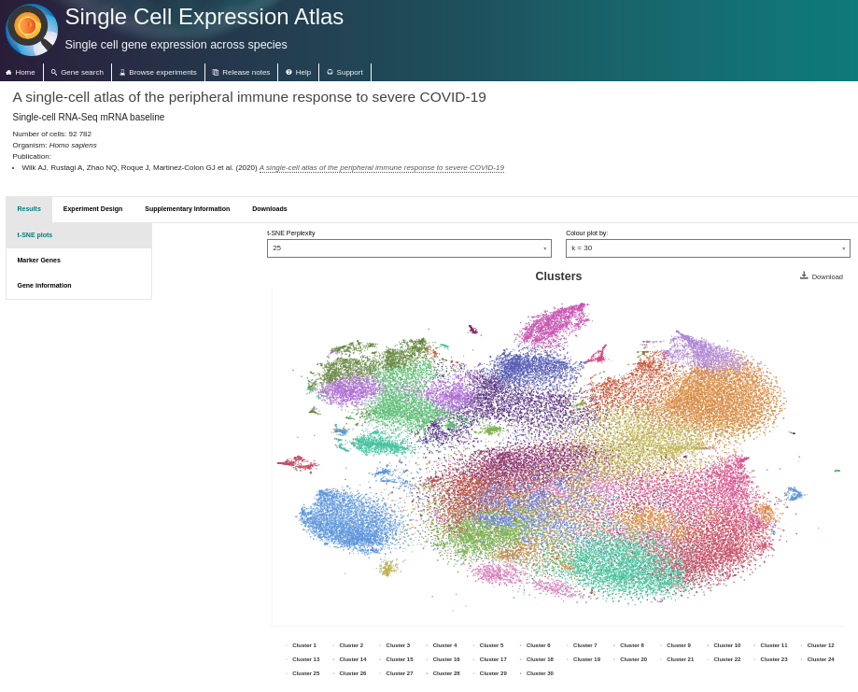
Part I. Transcriptomics | Resources
The Single Cell Expression Atlas
Database of scRNA-seq data
Processed gene expression data (read counts) open-access
Web interface of the single-cell expression atlas. scRNA-seq of immune response to severe COVID-19 (t-SNE). Source: https://www.ebi.ac.uk/gxa/sc/home.

Slide 13

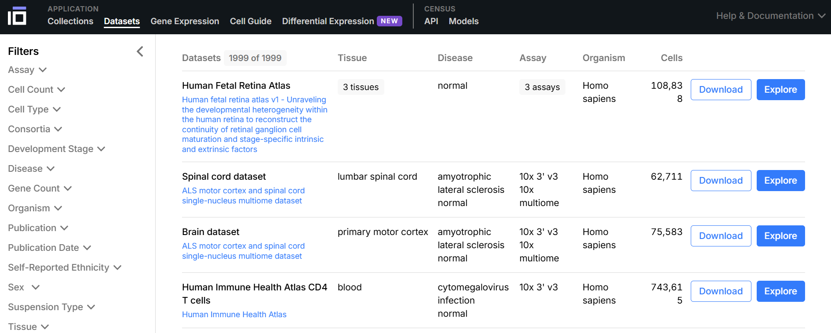
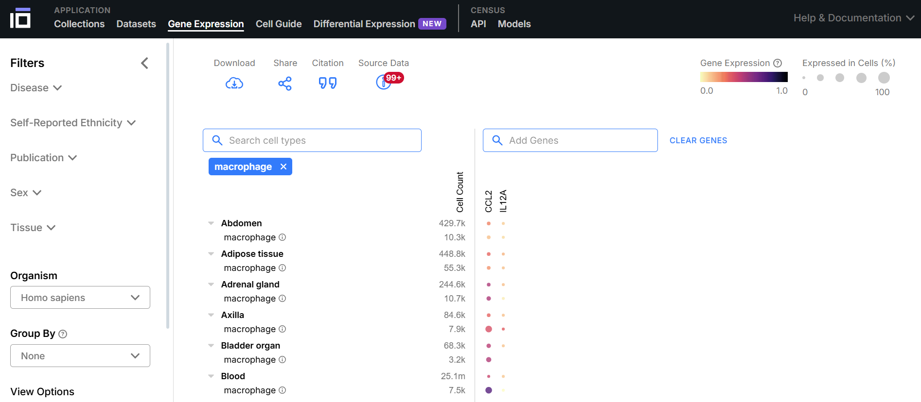
Part I. Transcriptomics | Resources
The Cell x gene database
Database of scRNA-seq data
Download datasets
Study gene expression of cell types

Slide 14
Part II. Single-cell transcriptomics | Concepts

Slide 15
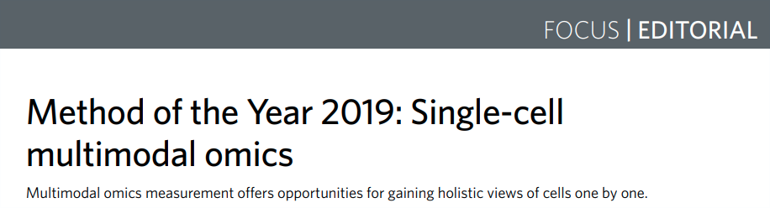
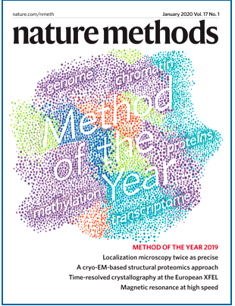
Part II. Single-cell transcriptomics | Concepts
What: Quantify the level of expression of genes of each individual cell of a tissue

Slide 16
Part II. Single-cell transcriptomics | Concepts
What: Quantify the level of expression of genes of each individual cell of a tissue
Why:
Track cell differentiation
Quantify tissue heterogeneity
Quantify diversity of microbiome…

Slide 17
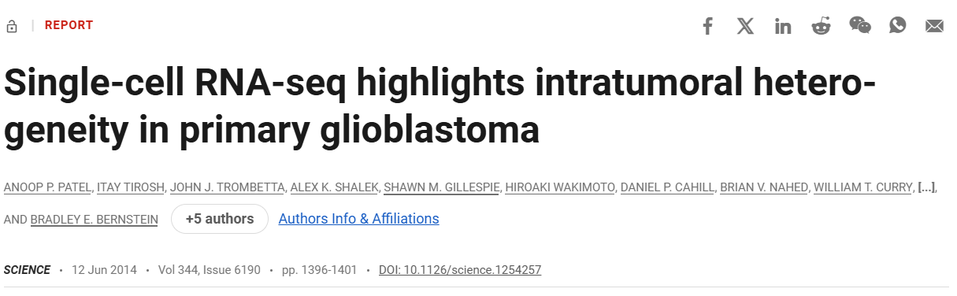
Part II. Single-cell transcriptomics | Concepts
Example:
GBM is an aggressive brain cancer
Tumors show a lot of heterogeneity,
but at the time it was unclear if all different cellular
profiles coexisted in individual tumors
Authors used scRNAseq:
Concluded that individual tumors are a mosaic of the cellular profiles, which explains their resistance to therapy
Identified a spectrum of cellular states & which ones could be potential therapeutic targets

Slide 18
Part II. Single-cell transcriptomics | Concepts
What: Quantify the level of expression of genes of each individual cell of a tissue
Why:
Track cell differentiation
Quantify tissue heterogeneity
Quantify diversity of microbiome…
How:
Droplet based (10X genomics) -> most used technique
Plate-based with unique molecular identifiers (UMIs): CEL-seq, MARS-seq
Plate-based without UMIs: Smart-seq2

Slide 19
Part II. Single-cell transcriptomics | Techniques
Droplet based (10X genomics)

Slide 20
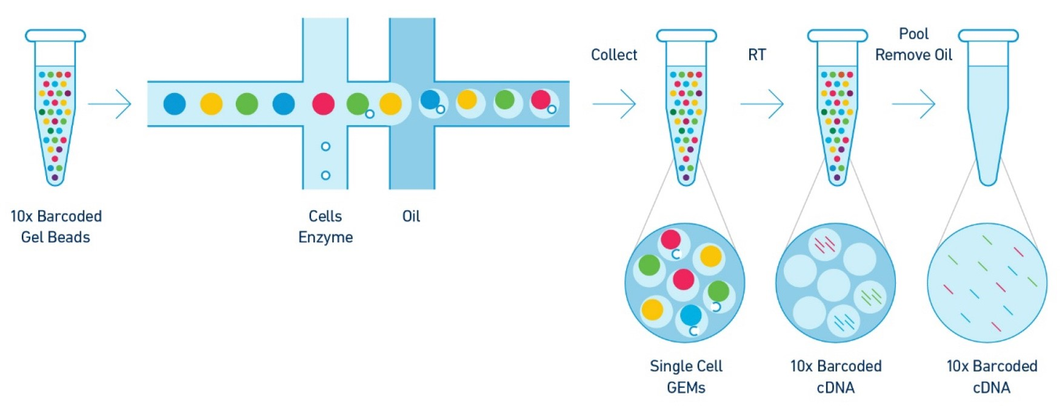
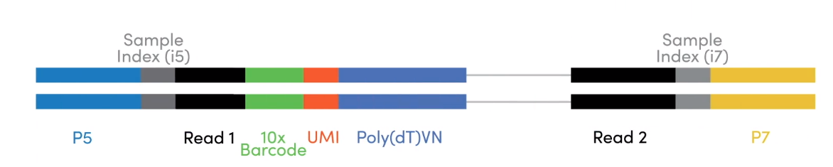
Part II. Single-cell transcriptomics | Techniques
Droplet based (10X genomics)
Single-cell suspension: get individual cells from tissue
GEM formation (nL size)
Barcode cDNA: cell lysis & reverse transcription
Amplification & library preparation
Sequencing: read cDNA sequences
Cell, reverse transcription (RT) enzyme, gel bead, water with lysis buffer
RNA
cDNA
UMI
Reads
Source: 10X genomics.

Slide 21
Part II. Single-cell transcriptomics | Techniques
Processing:

Slide 22
Part II. Single-cell transcriptomics | Techniques
Processing:
barcode-aware alignment (e.g., CellRanger, STARsolo)
error-correction and demultiplexing of cell barcodes
standard mapping on reference genome
deduplication of UMIs

Slide 23
Part II. Single-cell transcriptomics | Techniques
Processing:
barcode-aware alignment (e.g., CellRanger, STARsolo)
error-correction and demultiplexing of cell barcodes
standard mapping on reference genome
deduplication of UMIs
Final output: Gene expression matrix
Cells x genes/transcripts
Values: number of reads of a gene in a given cell
Other output files: FASTQ files with the raw sequencing reads, barcodes to link reads to individual droplets, UMIs to eliminate PCR duplicates

Slide 24
Part II. Single-cell transcriptomics | Techniques
Depth-cell number trade-off:
Depth = number of reads per cell

Slide 25
Part II. Single-cell transcriptomics | Techniques
Depth-cell number trade-off:
Depth = number of reads per cell
Higher depth -> more information about transcriptome, lowly expressed genes, subtle differences in expression between cell types

Slide 26
Part II. Single-cell transcriptomics | Techniques
Depth-cell number trade-off:
Depth = number of reads per cell
Higher depth -> more information about transcriptome, lowly expressed genes, subtle differences in expression between cell types
Current technologies can sequence 100 to 100,000 cells, with 1,000 to 100,000 reads/cell

Slide 27
Part II. Single-cell transcriptomics | Techniques
Depth-cell number trade-off:
Depth = number of reads per cell
Higher depth -> more information about transcriptome, lowly expressed genes, subtle differences in expression between cell types
Current technologies can sequence 100 to 100,000 cells, with 1,000 to 100,000 reads/cell
More cells help identify rare cell subtypes

Slide 28
Part II. Single-cell transcriptomics | Techniques
Depth-cell number trade-off:
Depth = number of reads per cell
Higher depth -> more information about transcriptome, lowly expressed genes, subtle differences in expression between cell types
Current technologies can sequence 100 to 100,000 cells, with 1,000 to 100,000 reads/cell
More cells help identify rare cell subtypes
Trade-off arises because of limited sequencing capacity

Slide 29
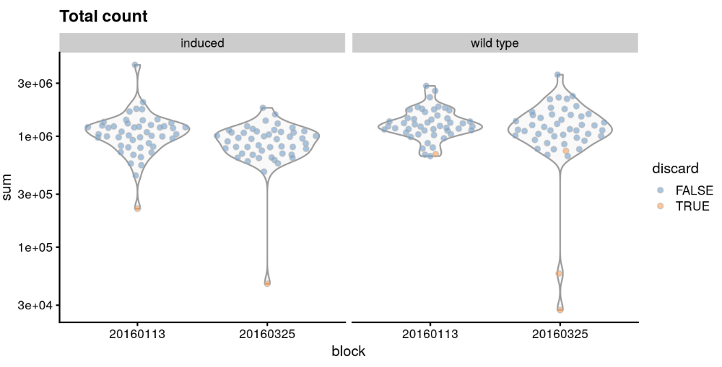
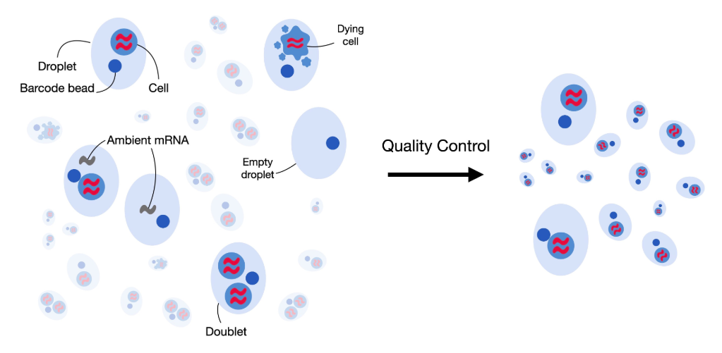
Part II. Single-cell transcriptomics | Analysis
Single-cell best practices guide (Nat Rev Genet; 2023) -> different methods, python code
Preprocessing & visualization:
QC: Remove low-quality cells (damaged or badly captured), e.g., based on low total counts/cell, proportion of mitochondrial reads and number of non-zero features, correct ambient RNA (SoupX R package), detect doublets (scDblFinder R package)
Example QC of scRNA-seq (total count/cell). Source: https://osca.bioconductor.org/quality-control.html
QC concepts of scRNA-seq. Source: https://www.sc-best-practices.org/preprocessing_visualization/quality_control.html

Slide 30
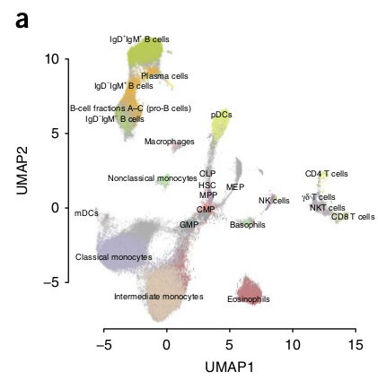
Part II. Single-cell transcriptomics | Analysis
Single-cell best practices guide (Nat Rev Genet; 2023) -> different methods, python code
Preprocessing & visualization:
Normalization: counts are normalized for library size differences and transformed to reduce variance
Feature selection: retaining genes that are highly variable
Dimensionality reduction: compact the data and reduce noise (PCA, or non-linear techniques like UMAP)
2D embedding of scRNA-seq of immune cell populations. a. UMAP. Source: Becht et al. Nature Biotechnology 2019.

Slide 31
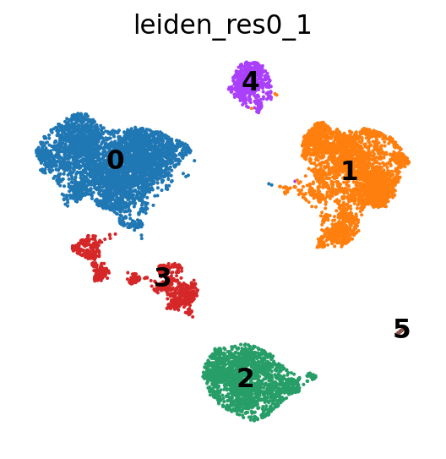
Part II. Single-cell transcriptomics | Analysis
UMAP algorithm:
CAREFUL with distance interpretation

Slide 32
Part II. Single-cell transcriptomics | Analysis
UMAP algorithm:
CAREFUL with distance interpretation
Cluster 5 actually closer to 4 than to 1

Slide 33
Part II. Single-cell transcriptomics | Analysis
UMAP algorithm:
CAREFUL with distance interpretation
Not only distance interpretation, some say the whole concept is problematic and shouldn’t be used

Slide 34
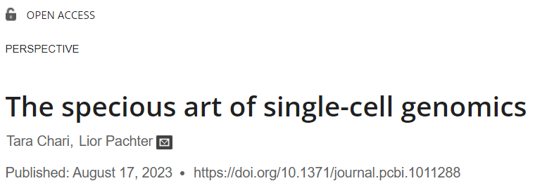
Part II. Single-cell transcriptomics | Analysis
UMAP algorithm:
CAREFUL with distance interpretation
Not only distance interpretation, some say the whole concept is problematic and shouldn’t be used
Authors argue that there is little theoretical support for 2D UMAP visualization, that it has little utility and propose other tools instead (ex dendrograms, graph-based diagrams…)

Slide 35
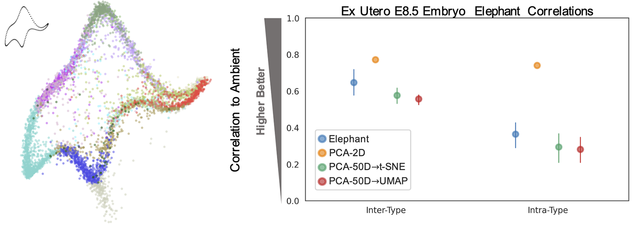
Part II. Single-cell transcriptomics | Analysis
UMAP algorithm:
CAREFUL with distance interpretation
Authors show that representing 2D clusters as a “von Neumann elephant” can be as good as/better than the representation given by UMAP (when focusing on inter- and intra-cluster distances)

Slide 36
Part II. Single-cell transcriptomics | Analysis
Single-cell best practices guide (Nat Rev Genet; 2023) -> different methods, python code
After preprocessing:
Cell clustering: group similar expression profiles (biological states)

Slide 37
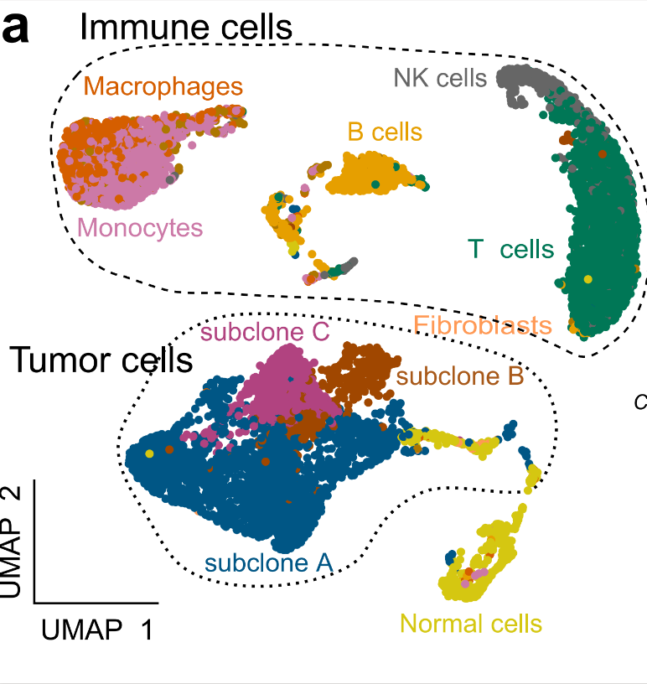
Part II. Single-cell transcriptomics | Analysis
Single-cell best practices guide (Nat Rev Genet; 2023) -> different methods, python code
After preprocessing:
Cell clustering: group similar expression profiles (biological states)
Annotation: assign cell types to each barcode
2D embedding of scRNA-seq of mesothelioma. Source: MESOMICS project, N. Alcala WCR grant application.

Slide 38
Part II. Single-cell transcriptomics | Analysis
Single-cell best practices guide (Nat Rev Genet; 2023) -> different methods, python code
After preprocessing:
Cell clustering: group similar expression profiles (biological states)
Annotation: assign cell types to each barcode
Copy number variant (CNV) calling: detect chromosome amplifications & deletions -> identify tumor cells
2D embedding of scRNA-seq of mesothelioma. Source: MESOMICS project, N. Alcala WCR grant application.

Slide 39
Part II. Single-cell transcriptomics | Analysis
Single-cell best practices guide (Nat Rev Genet; 2023) -> different methods, python code
After preprocessing:
Cell clustering: group similar expression profiles (biological states)
Annotation: assign cell types to each barcode
Copy number variant (CNV) calling: detect chromosome amplifications & deletions -> identify tumor cells
Differential expression: similar to annotation, annotate clusters by inferring genes that are statistically significantly over- or underexpressed between groups, uncover genesets which potentially explain observed phenotypes
2D embedding of scRNA-seq of mesothelioma. Source: MESOMICS project, N. Alcala WCR grant application.

Slide 40
Part II. Single-cell transcriptomics | Analysis
Single-cell best practices guide (Nat Rev Genet; 2023) -> different methods, python code
After preprocessing:
Cell clustering: group similar expression profiles (biological states)
Annotation: assign cell types to each barcode
Copy number variant (CNV) calling: detect chromosome amplifications & deletions -> identify tumor cells
Differential expression: similar to annotation, annotate clusters by inferring genes that are statistically significantly over- or underexpressed between groups, uncover genesets which potentially explain observed phenotypes
Cell-cell communication: understand intercellular signaling pathways (ex ligand-receptor relationships allow tumor cells to escape the immune response) by estimating protein abundance using gene expression information and uncovers which pairs of cell types produce complementary ligand-receptor molecules
2D embedding of scRNA-seq of mesothelioma. Source: MESOMICS project, N. Alcala WCR grant application.

Slide 41
Part II. Single-cell transcriptomics | Analysis
Single-cell best practices guide (Nat Rev Genet; 2023) -> different methods, python code
Alternative annotation methods:
Trainable models:
- Celltypist: ML tools which can be trained on annotated data to annotate other datasets
- Emerging methods: foundation models: models pretrained on massive amounts of data to serve as a universal model of cell states, can be used for downstream analyses

Slide 42
Thank you
N. Alcala & L.Mangé
Computational Cancers Genomics Team
November 25th 2025

Slide 43
Appendices
N. Alcala & L.Mangé
Computational Cancers Genomics Team
November 25th 2025

Slide 44
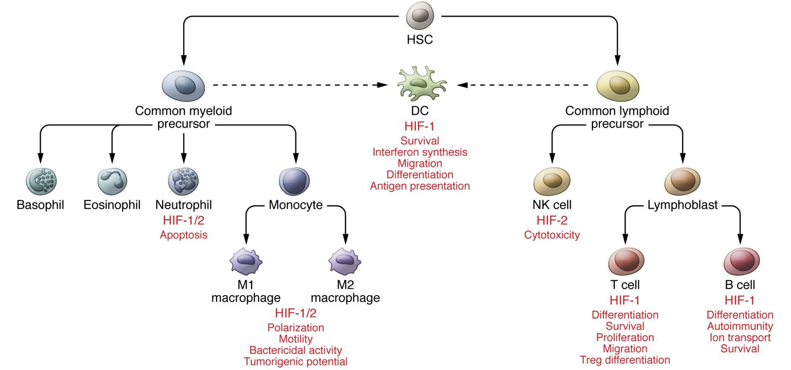
Part I. Transcriptomics | Concepts
Tissue heterogeneity: Stroma and Microenvironment
Stromal cells (connective tissue cells)
Fibroblasts: synthesize the extracellular matrix and collagen, initiate inflammation and immune response
Immune cells
Dendritic cells: present antigens
Macrophages: perform phagocytosis
T cells: cytotoxic (CD8+), helper (CD4+)
Neutrophils: promote inflammation, phagocytosis
Immune cell differentiation. Source: Taylor et al. J. Clin Invest 2016.

Slide 45
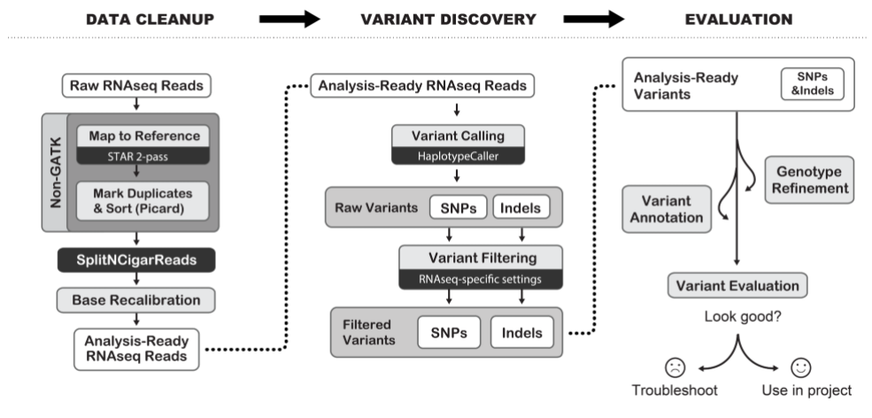
Part I. Transcriptomics | Analysis
Variant discovery: small variant calling
Goal: discover (or validate) small somatic variants (single nucleotide polymorphism or indels)
Medical relevance: many diseases are driven by small variants
Methods: Mapping to reference, and heavy filtering using estimated sequencing error rates and databases of known germline variants
Schematic of the Genome Analysis ToolKit (GATK) best practices for small variant discovery from RNA-seq; Source: https://gatk.broadinstitute.org

Slide 46
Part I. Transcriptomics | Analysis
Variant discovery: small variant calling
Caveats:
High false positive rate (due to sequencing error and high depth at some locations)
High false positive rate (due to variants in low-expression genes)
Useful for validation of mutations from WGS/WES
Useful for allele specific expression quantification
Schematic of the Genome Analysis ToolKit (GATK) best practices for small variant discovery from RNA-seq; Source: https://gatk.broadinstitute.org

Slide 47
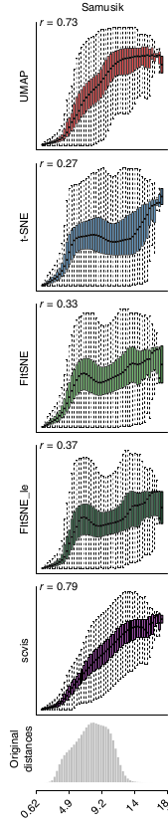
Part II. Single-cell transcriptomics | Analysis
UMAP algorithm:
similarities between points in the original (high-dimensional) space are computed using fuzzy simplicial sets memberships
Similarities between points in the output (low-dimensional) space are computed using Student distributions with 1DF
A cost function (the cross-entropy) is optimized
Notes: UMAP has a faster running time because cross-entropy is easier to optimize, and is claimed to better preserve long distances
Preservation of original distances by UMAP and t-SNE. Source: Becht et al. Nature Biotechnology 2019.

